Slide 1



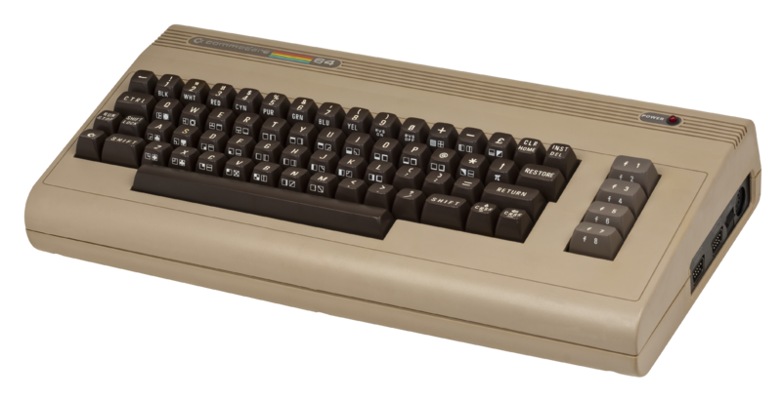
In Depth Introduction to Containers On Microsoft Platforms
Dave Strebel
Cloud Technical Specialist
Microsoft
@HybridCloud_Guy
About Me:
Mixture of infrastructure and app\dev
Love technology and beer
Converted Windows fan
Docker Meetup Organizer
blogs.technet.com/hybridguy

Slide 2
The tension between developers and IT
Developers need to create applications at a competitive rate without worrying about IT
New applications run smoothly on developer’s machines, but malfunction in traditional IT server
Developer productivity and application innovation become suspended
IT needs to manage servers and maintain compliance with little disruption
IT unsure of how to integrate unfamiliar applications, require help from developers
IT is unable to focus on server protection and application compliance
Developers
IT
How do you empower developers to create innovative applications at a competitive rate without disrupting IT’s ability to manage servers and maintain control?
Containers

Slide 3
Old model was to deploy apps on VM’s and use this as scale model

Slide 4
Scale up or scale out?
App
VM

Slide 5
Scale out: increased complexity for management, deployment, DevOps
App
App
App

Slide 6
Next: Break application into components
Web
API
Web
API
Web
API

Slide 7
What if I only want to scale parts of my app? Added complexity for DevOps
Web
API
API
API

Slide 8
How about even more? ☹
Web
API
Web
API
Web
API
Web2
API2
Web2
API2
Web2
API2
Cache
Cache
Cache

Slide 9
What is a container anyway?
Is it a lightweight Virtual Machine?
Shared kernel, very fast start-up, and repeatable execution.
Containers run on: Linux, Windows (soon), VM’s, physical servers, Azure, hosted clouds, private clouds, etc.

Slide 10
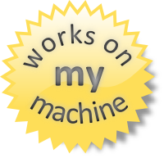
Why containers & microservices?
Fast deployment, instant startup
Density, partitioning, density
Reusable and portable code
Reduce developer friction
  “Build, Ship, and Run”
Diverse developer framework support

Slide 11
Containers vs. VM’s
App
A
App
A
App
B
App
C
Virtual Machines
  Each VM has independent, full OS
  Full isolation
  Separate app frameworks
  Support features such as live migration
Containers
  Shared Host OS
  Near instant start-up
  Processes in containers are isolated
  Dependent app services and libraries are tied to container (layers)
  All containers on a host will share the same guest OS version
App
Framework
App
Framework
App
Framework
App
Framework
VM
Guest OS
Guest OS
Guest OS
Guest OS
Hypervisor
Physical Server
App
A
App
A
App
B
App
B
App
C
App
C
Container
App
Framework
App
Framework
App
Framework
Guest OS w/ Docker
Hypervisor
Physical Server

Slide 12
Constructing a container
Container tied to dependencies
  Base image
  Added files, binaries, libraries
  App platforms. Eg – MongoDB, apache, node.js, etc.
  Configuration changes
  Networking
  Custom code
Can think of these as “layers”
  One can build new layers on top of an existing container
  Docker will pull these required dependencies to install/run

Slide 13
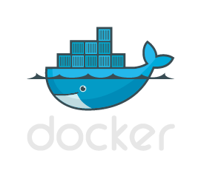
Let’s go over some Docker basics

Slide 14
Web
API
DB
Docker Hub/
Repository
Deploy
containers
Publish
Pull
images
Create images
(docker build)
Web
Web
Web
API
API
DB
Update, customize, add code

Slide 15
Windows Containers
Windows Server 2016 will provide 2 container types:
  Windows Server Containers
  Hyper-V Containers
Both provide high degree of Windows Server application compatibility
Both integrated with Docker Engine so compatible with Docker Client and Docker APIs

Slide 16
Containers and Azure
Install manually on supported Linux VM’s
Docker VM Extension
Built-in to Windows Server 2016 TP
Marketplace
  Pre-installed on Ubuntu
  Multi-container composed apps (eg – Wordpress+mySQL)
  Docker Trusted Registry, Jenkins, etc.
Azure Container Service

Slide 17
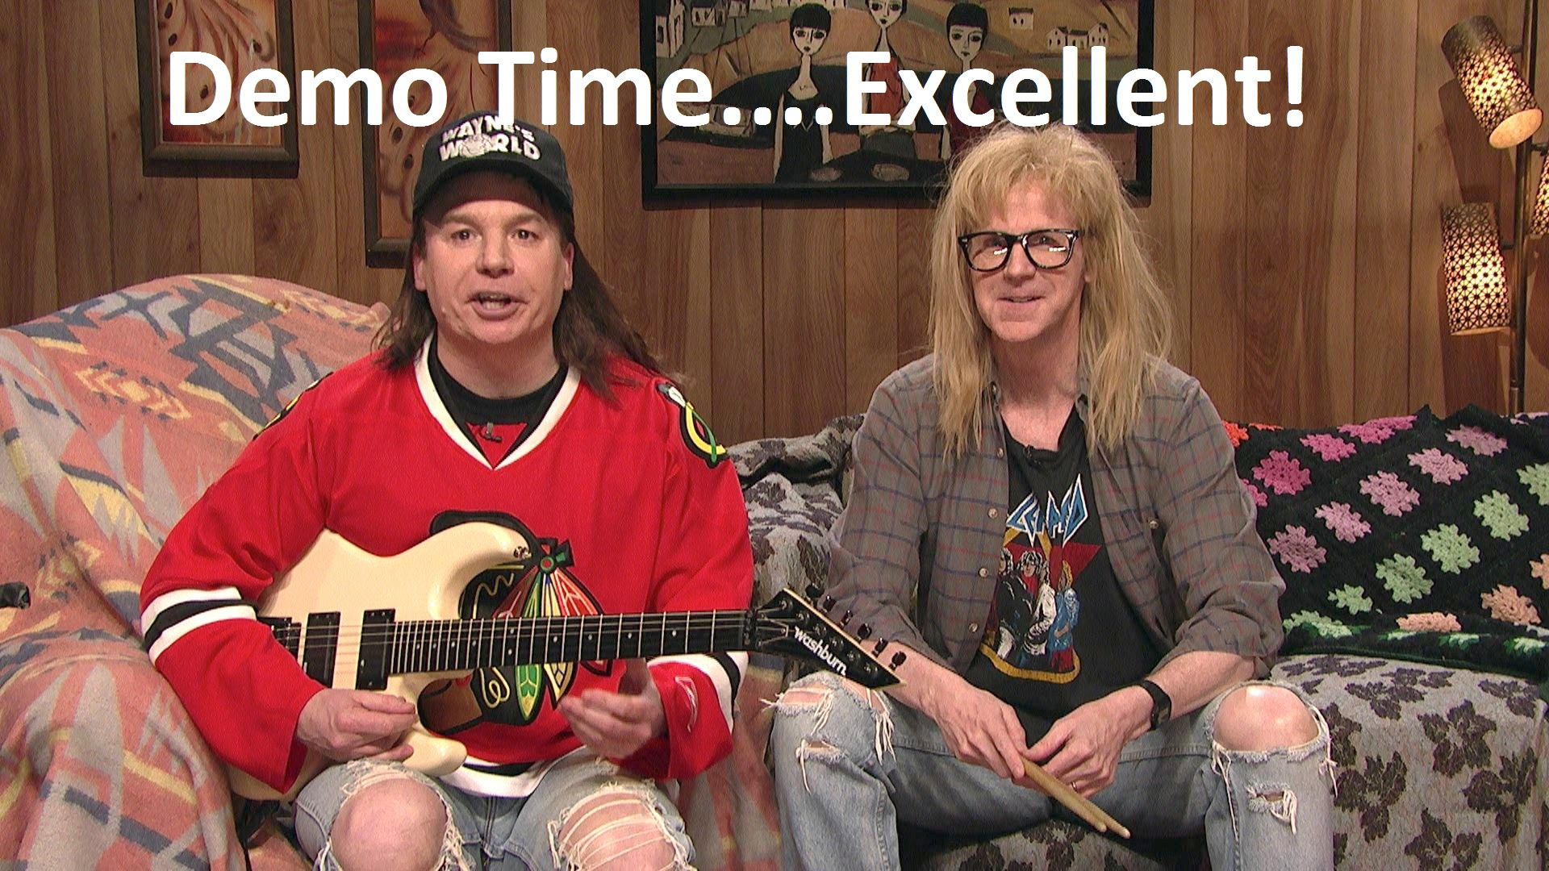

Slide 18
How are customers managing these production environments?

Slide 19
Container Management in the Enterprise
  Cluster deployment and management
  Scheduling and automation
  Service Discovery
  Container
  Registry
  Container placement and resource mgmt
  Continuous deployment/
  integration
  Monitoring and Logging
  Security

Slide 20


Apache Mesos / Marathon
Mesos
  Open source cluster manager platform
  Not just for containers (Hadoop, Spark, Elastic Search, etc.)
  Scales to 10,000’s of nodes
  Used by Twitter, AirBnB, Apple
  Master/Slave with standby Masters (Zookeeper quorum)
Marathon
  Framework for long running apps on Mesos clusters
  Can be combined with other frameworks such as Chronos, Aurora, or Storm
  One scheduler watching the other

Slide 21
Azure Container Service
Streamlined provisioning of Apache Mesos Clusters
VM Scale Sets
Layered support of Swarm, Marathon, and Chronos
Docker tooling and API support
Integrated app management and scaling
Linux and Windows Server containers
Public and private cloud

