Slide 1
Regional and International Officer’s Meeting
December 7, 2011

Slide 2
Agenda
Introduce new Vice President
Dave Thorn
Administration Items / Paperwork / Expense Reporting / Website
Meeting Metrics / MeasureIT
Discussion Items / Regional Updates
Planning for Next Year

Slide 3
Agenda
Free Social Media Tools
Regional use of Social Media and Virtual Meeting Tools
Kansas City
Linkedin
Eventbrite
Ohio Valley
Private Virtual Meeting using Go to Meeting
CMG Netherlands
New startup region based on Social Media Tools

Slide 4
International Regions
Australia*
Austria & Eastern Europe
Brazil
Canada
China
Central Europe
Italy
Netherlands
South Africa*
UK
* Region not Active

Slide 5
US Regions
ARM Group
Greater Boston
Connecticut
Florida
Gulf Coast
Greater Atlanta
Kansas City
Midwest
Minneapolis-
St Paul
National Capital
Area*
Greater
New York
Northern
California
Northwest*
Ohio Valley
Philadelphia
Phoenix*
Portland Area
Rocky Mountain
St Louis
Salt Lake City*
Southern
Southern
California
Southwest

Slide 6
Administration / Paperwork
Annual Report goes to state of Illinois
Deadline corresponds with creation of region
Financial forms go to the IRS
April 15 – deadline to CMG
August 15 – deadline to IRS
Regional expenses must be filed by March 31 and preferably sooner

Slide 7
Expense Reporting
Policy
The regions collectively receive $14K to cover meeting expenses. Vice President authorizes funds to be disbursed.
Fiscal year runs from April 1 to March 31 of the next year.
Travel expense must be submitted using the CMG Travel & Expense Spreadsheet.
Non Travel expenses can be submitted using a Check request.

Slide 8
Expense Reporting
Procedure for Travel Related Expenses
Contact Vice President to get approval for expense reimbursement before you obligate your region.
Complete EXCEL spreadsheet to document and classify the expenses incurred.
Mail (snail mail) signed EXCEL spreadsheet and original receipts to corporate bookkeeper.
Name and address of LGS Bookkeeping is included in EXCEL workbook.

Slide 9
Expense Reporting
Procedure (cont)
E-Mail the EXCEL workbook to the following people:
CMG VP (CMGVP@CMG.org)
Corporate Bookkeeper (LGStermer@aol.com)
CMG Treasurer (Treasurer@CMG.org)
The Vice President will approve the E-Mail request
The corporate bookkeeper will process the transaction once the original paper work is received.

Slide 10
Expense Reporting
Procedure (cont)
If you are reimbursing an invited speaker for his / her travel related expenses, have the speaker complete the spreadsheet and E-Mail it to you for your approval Then forward to the E-Mail to the three individuals listed on the previous foil.
The original receipts and a hardcopy of the spreadsheet still need to be mailed to Corporate bookkeeper The speaker or the regional chair can take care of this.

Slide 11
Expense Reporting

Slide 12
Expense Reporting

Slide 13
Expense Reporting

Slide 14
Expense Reporting
Procedure for Non Travel Related Expenses
A CMG Check Request can be used for these types of expenses, such as:
Meeting Room Fees
Gifts for attendees
Equipment rental / purchase
The same process flow is used for both types of expense documents and original receipts are still needed.

Slide 15
Expense Reporting
Complete check request by supplying the following items:
Name and address of person to be reimbursed
Description of expense along with invoice # and date
Dollar amount of expense
Note – Do not change the accounting information, regional reimbursement is account # 113.832.

Slide 16
Expense Reporting

Slide 18
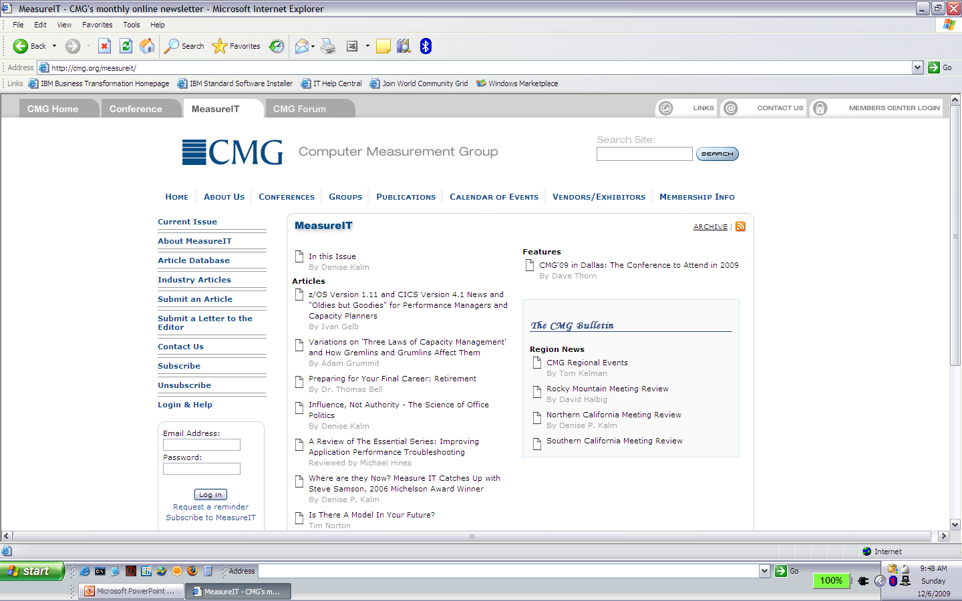
MeasureIT

Slide 19
Planning for Next Year
Pick a meeting date and start working toward it
Tools
Speakers/Sponsors Treasure Hunt
Talk to vendors and presenters while you’re here at the conference
Get business cards
Identify other regions you can work with
Contact CMG attendees who are in your area but not currently members
CMG 2010 attendee list will be sent to you early January
MeasureIT list will be sent February
Calendar entries
MeasureIT is our friend!

Slide 20
Social Media Tools
Facebook
LinkedIn
Twitter
EventBrite

Slide 27
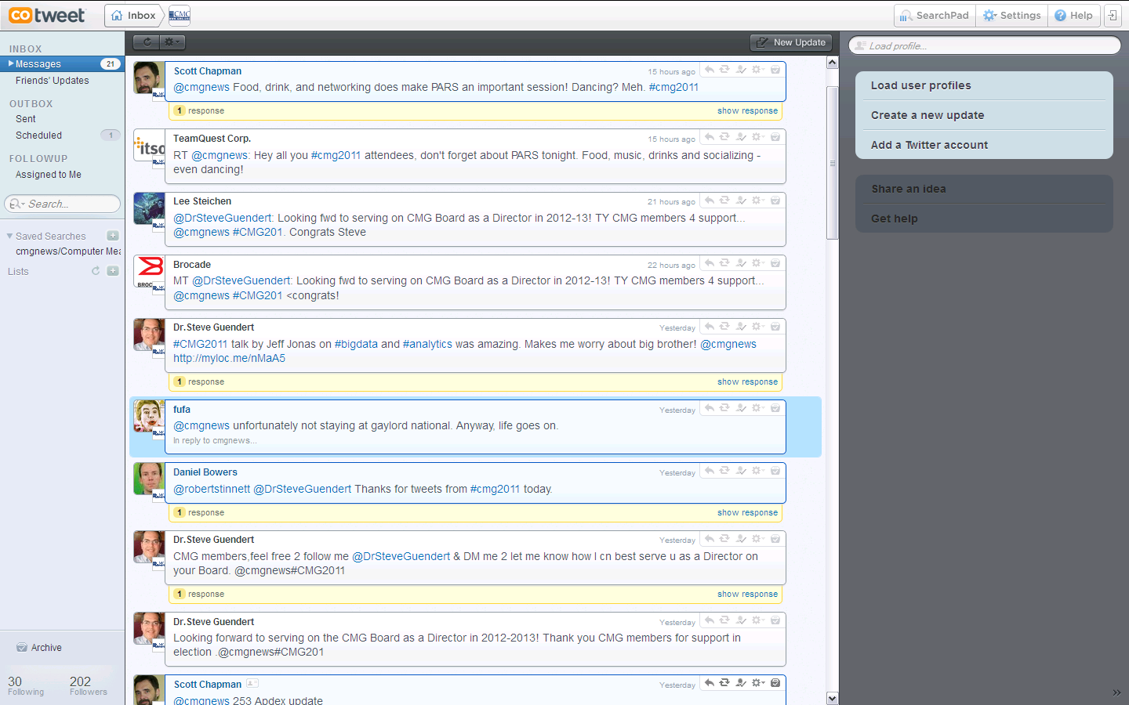

Slide 28
Regional Use of Social Media
Kansas City
LindedIn
Eventbrite
Ohio Valley
Private Virtual Meeting using Go to Meeting
Netherlands
New startup region using Social Media tools

